Slide 1

-By Argumentative Arrays 2.O
Beyond the Headlines, Into the heart of the story – Explore the world with Us!

Slide 2
Introduction
Welcome to our news website, your reliable source for credible and timely information. We are dedicated to bringing you the latest updates from around the globe, covering a wide range of topics such as current events, politics, economy, technology, health, and more. Our team of seasoned journalists and reporters work tirelessly to deliver unbiased news and in-depth analysis, empowering you to make informed decisions. Whether you are a curious reader or a knowledge seeker, we aim to keep you engaged and informed through our comprehensive coverage. Stay connected with us to explore the world of news, unraveling stories that shape our lives, and gaining valuable insights into the ever-changing world we live in. Thank you for choosing us as your trusted news partner.

Slide 3

Working
Content Creation and Editorial Process
Content Management System (CMS):The news website uses a Content Management System to organize, manage, and publish articles and other media content. The CMS allows editors to schedule content for publication, categorize articles, and add relevant tags for easy navigation.
Web Hosting and Servers: The news website is hosted on web servers, which are computers connected to the internet. These servers store the website's files, including articles, images, videos, and other media.
Front-End Development
&
Back-End Development
Responsive Design
User Preferences: Website owners use analytics tools to track user behavior, engagement, and popular content. This data helps in understanding audience preferences and improving the website's performance.

Slide 4
Abstract
At the core of our platform lies a team of dedicated journalists and content creators who work tirelessly to deliver in-depth and well-researched articles. Our editorial process ensures that each piece of news undergoes rigorous fact-checking and verification before publication, ensuring the delivery of trustworthy and credible information to our readers.
With a user-friendly interface and responsive design, our website provides an engaging and seamless browsing experience across various devices. Real-time updates and live feeds keep our audience connected to breaking news as it unfolds.
As we strive to become the go-to source for news, we value our readers' feedback and encourage open dialogue. We prioritize community engagement and offer opportunities for readers to share their perspectives through comments and user-generated content.
Our commitment to delivering timely, accurate, and diverse news makes our website a trusted destination for individuals seeking quality journalism. With a finger on the pulse of global events, we aim to empower our audience with knowledge, enabling them to make well-informed decisions in an ever-changing world.

Slide 5


Slide 6


Slide 7
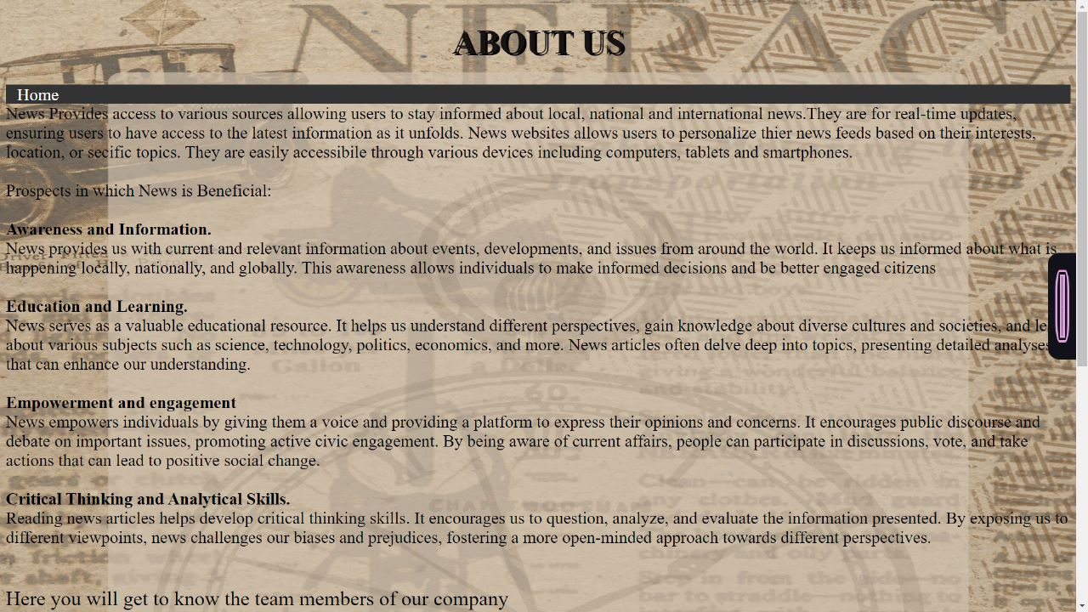

Slide 8


Slide 9
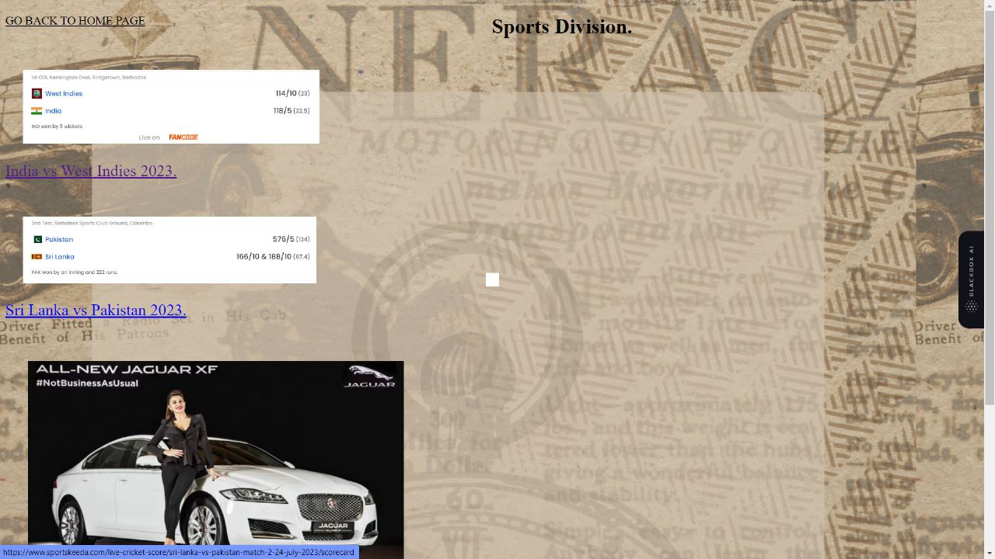

Slide 10
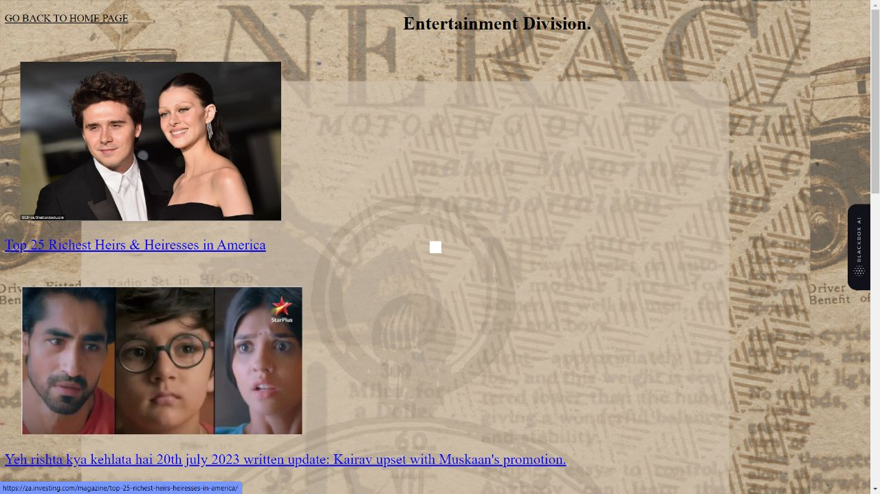

Slide 11
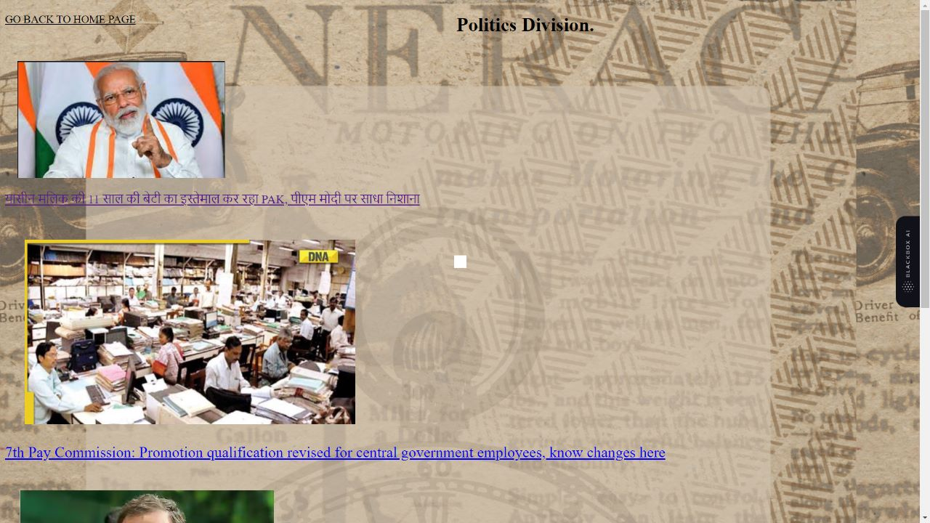

Slide 12
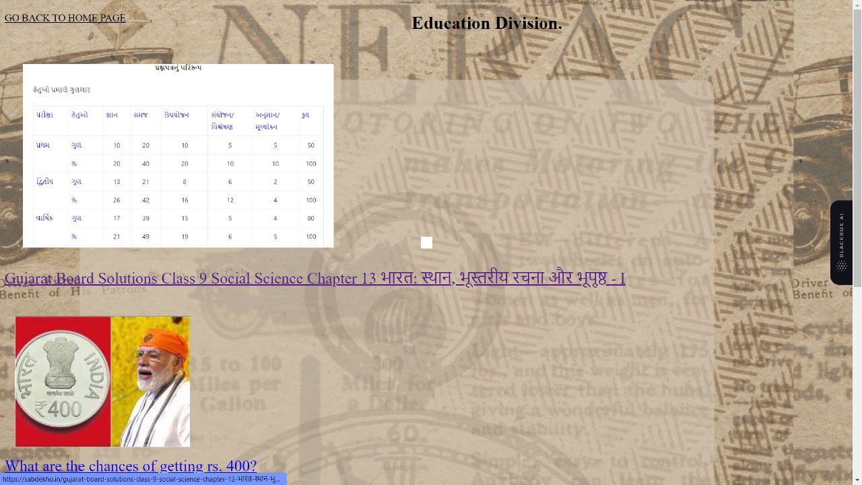

Slide 13


